Slide 1
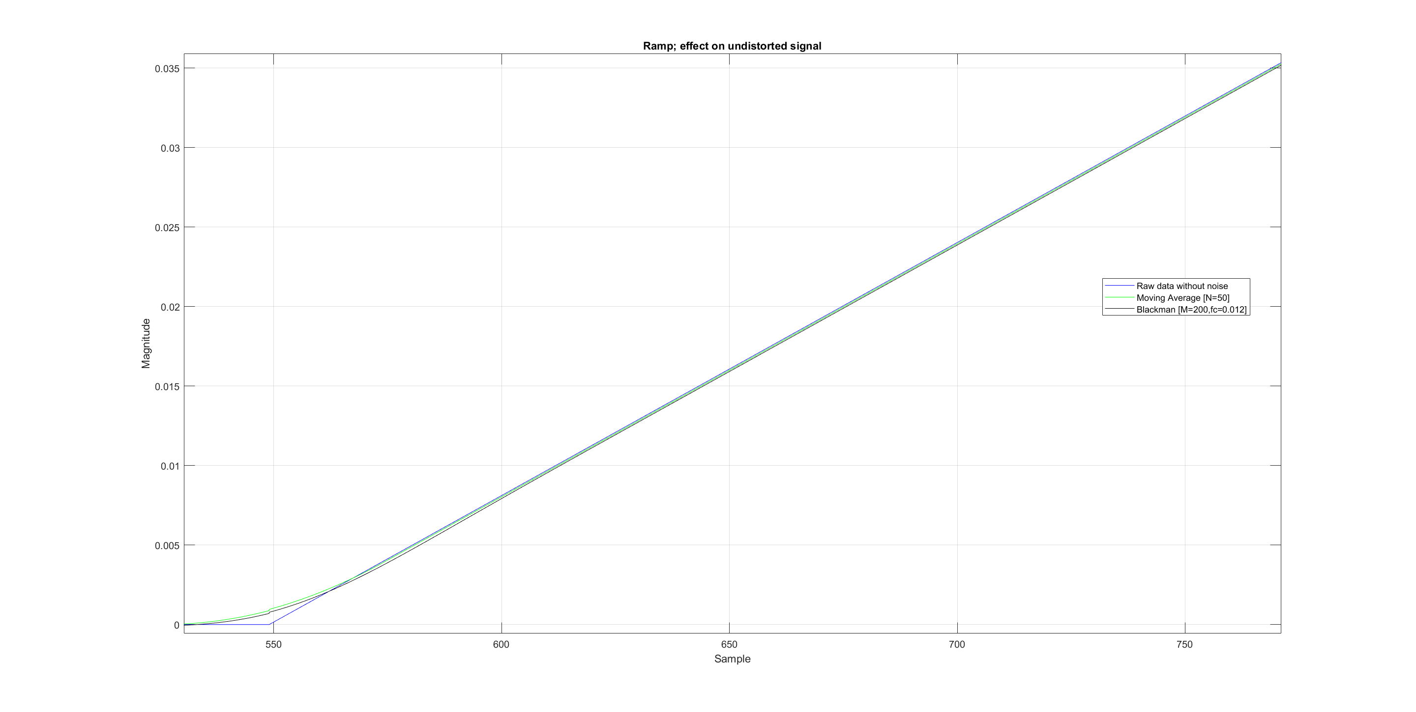
Introduction to Robotics and Mechatronics
GROUP 2.5
Benson Chalethu
Pietro Griffa
Ingvar Groza
PostLab 05
Q1
As you can see both filters work well. What you don’t see is the delay. The blackman filter would have a bigger delay. Because we have data presampled we can implement this filter with noncausal behavior.
We prefer the blackman filter because one can steer the behavior better.

Slide 2
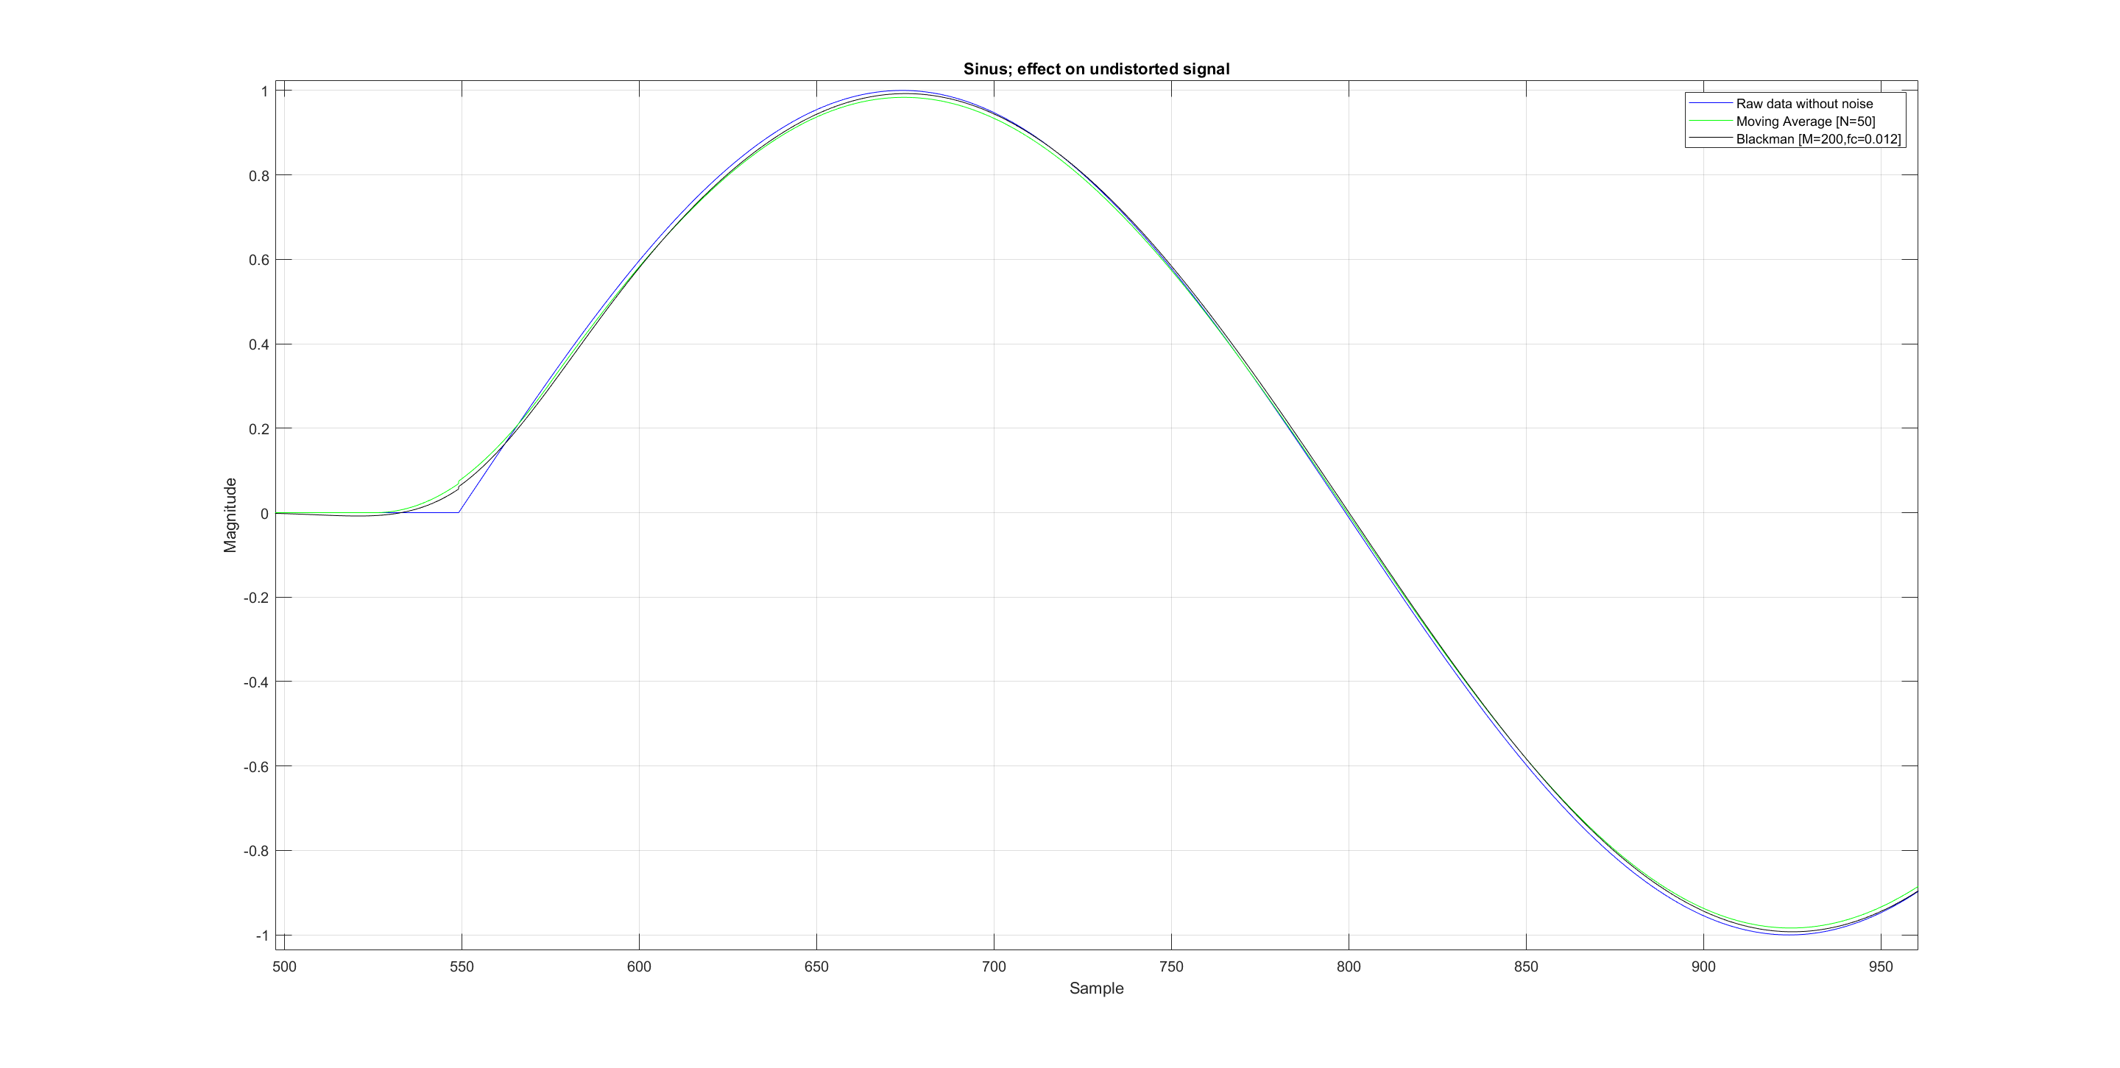
Q1 continued
With the parameters chosen as in the matlab plots, there is really no big difference in both filters. The moving average filter attenuates a little bit more if you watch closely in the Sinus curve but not significantly.

Slide 3
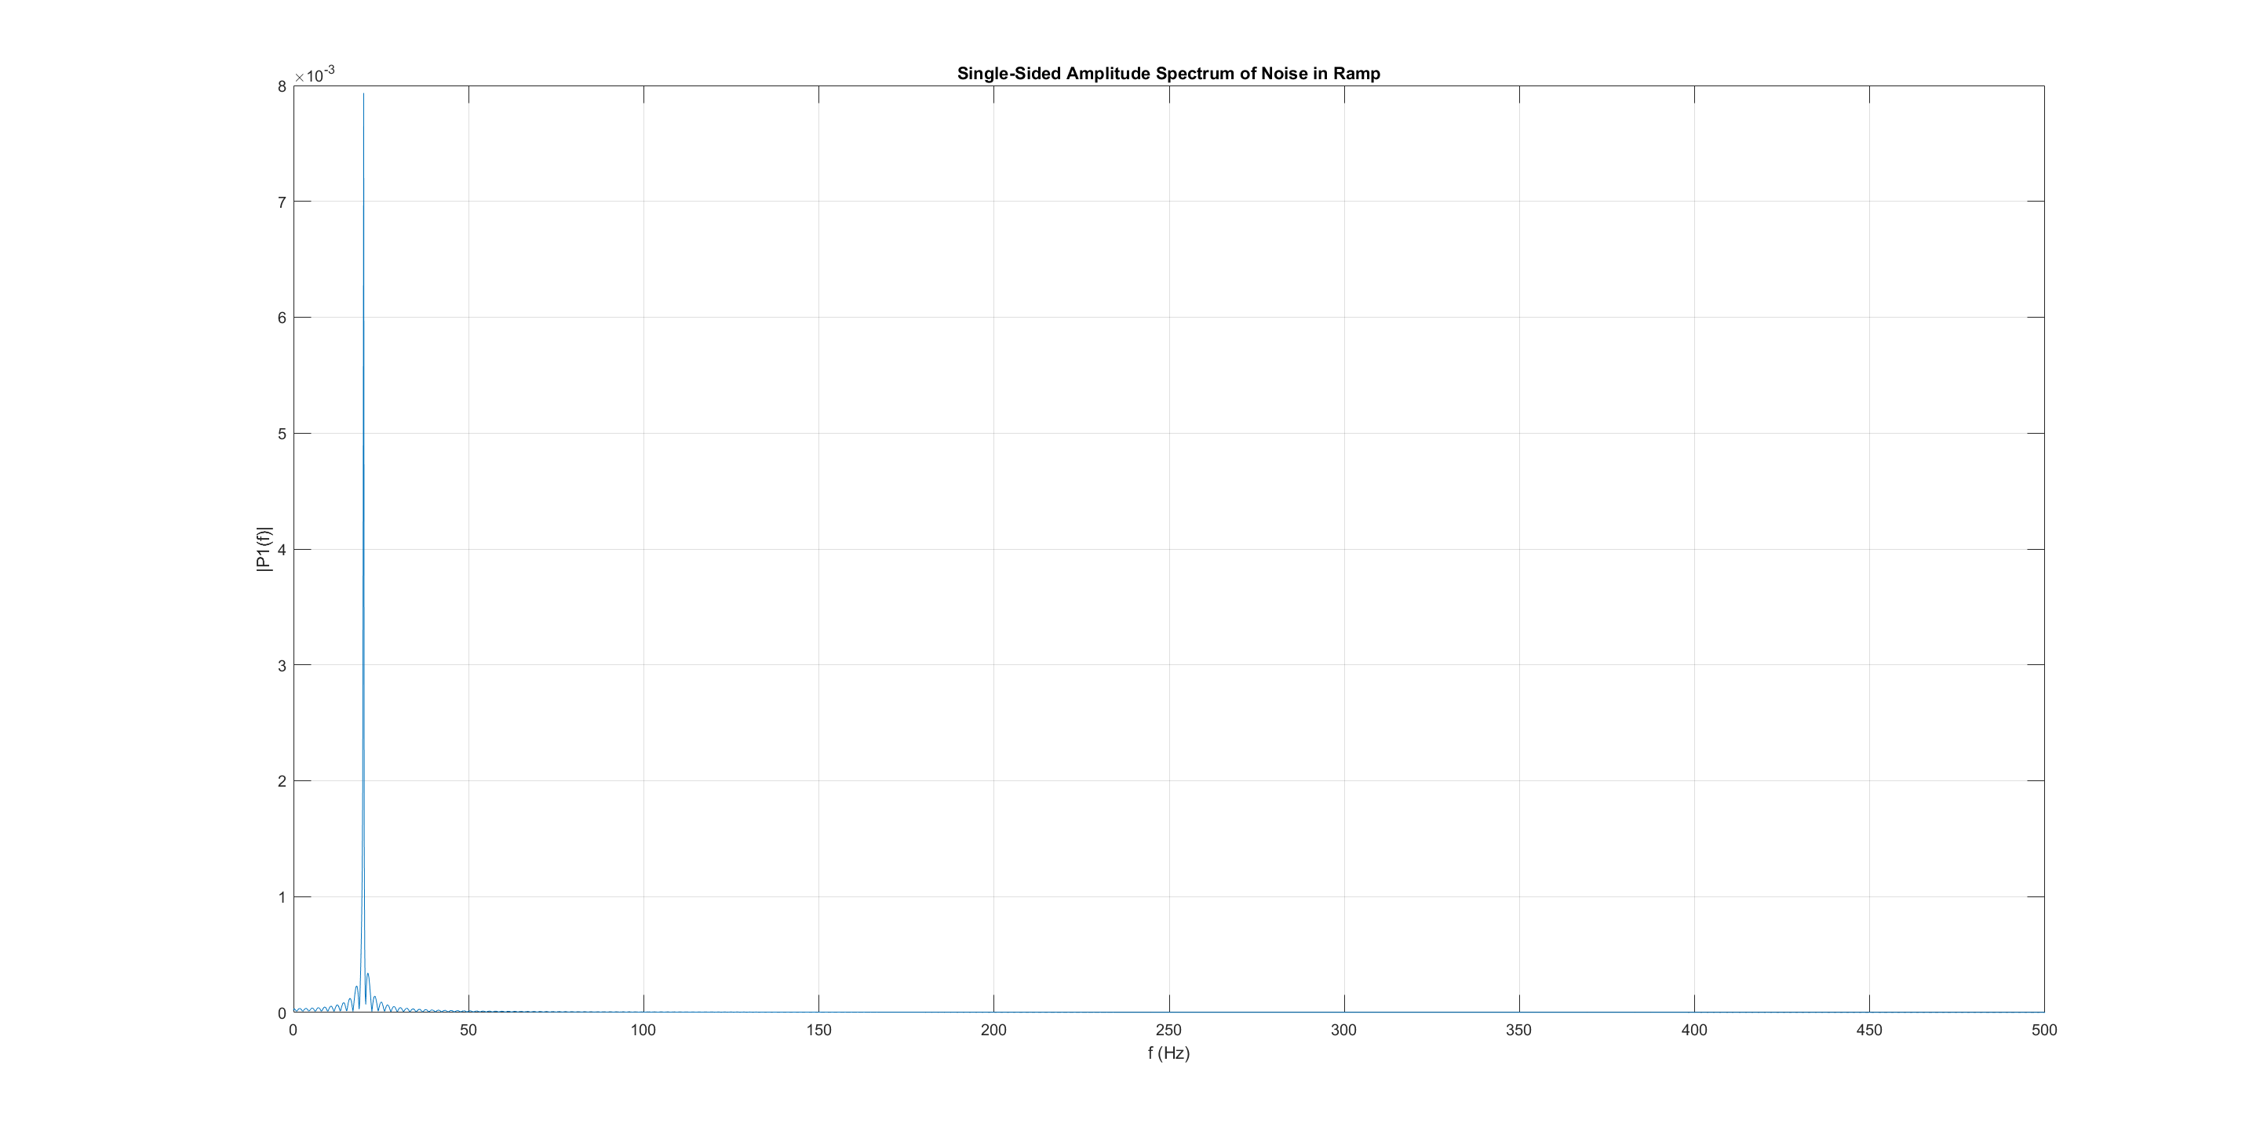
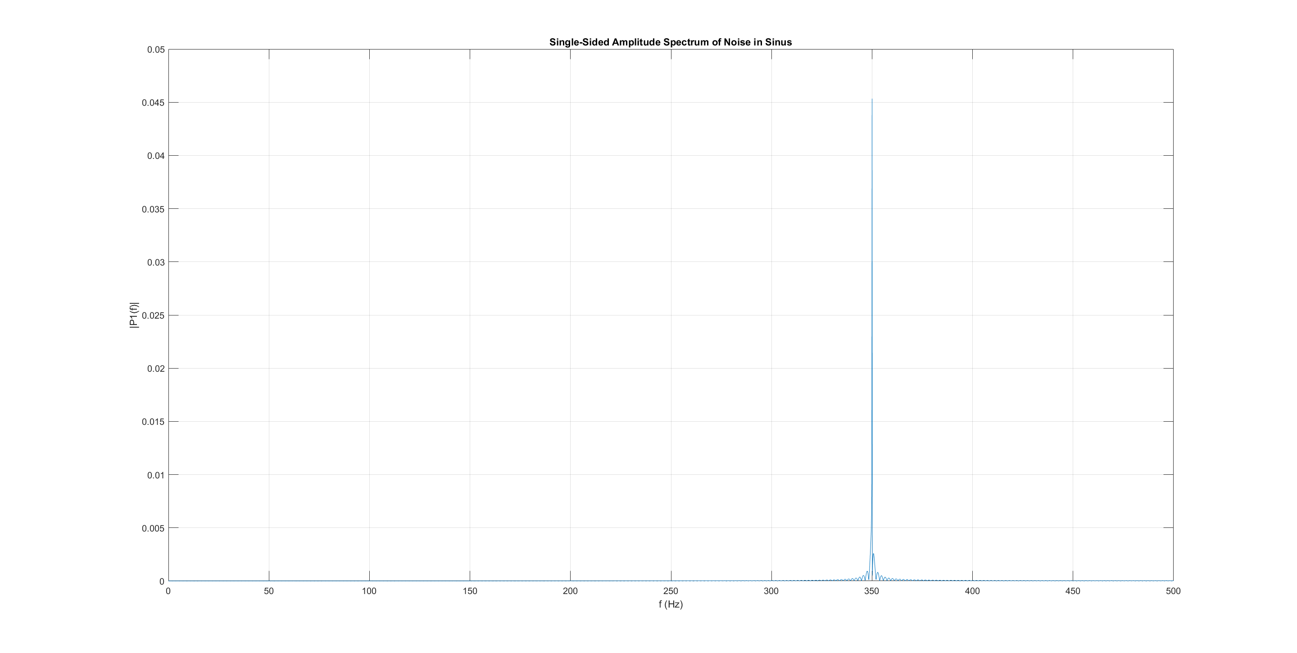
Q2
By subtracting the raw signal from the noised signal we can isolate the noise signal. Then by taking the fft we could find the frequencies on with noise occurred, see fft plots below:

Slide 4
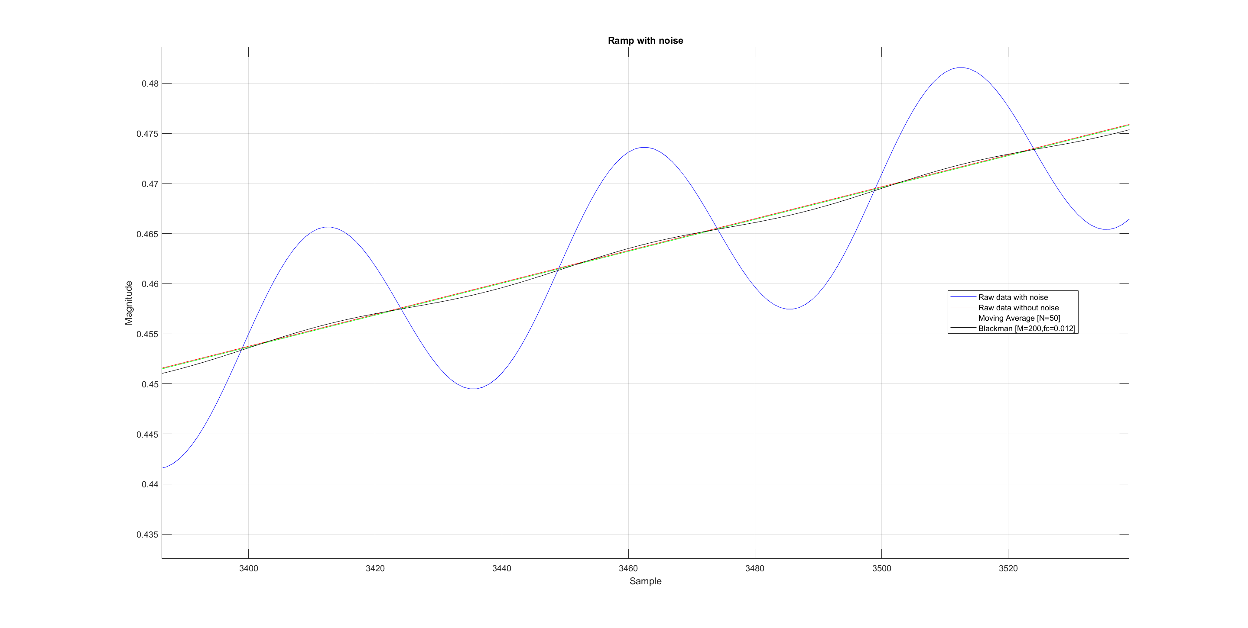
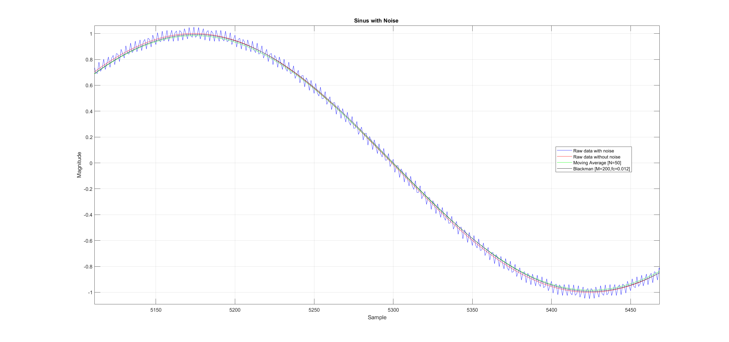
Q2 continued
The filter parameters for the blackman filter then got found very quickly (M=200, fc=0.012). The moving average parameter needed some tries until getting best results. We resulted in choosing N=50.

Slide 5
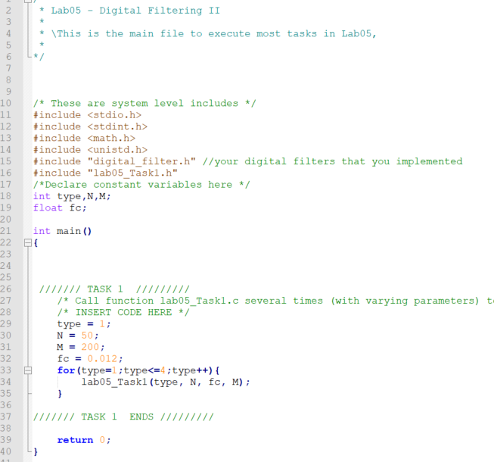
Q3 Source code
All source code from Q1 to Q4:
Lab05_test.c

Slide 6
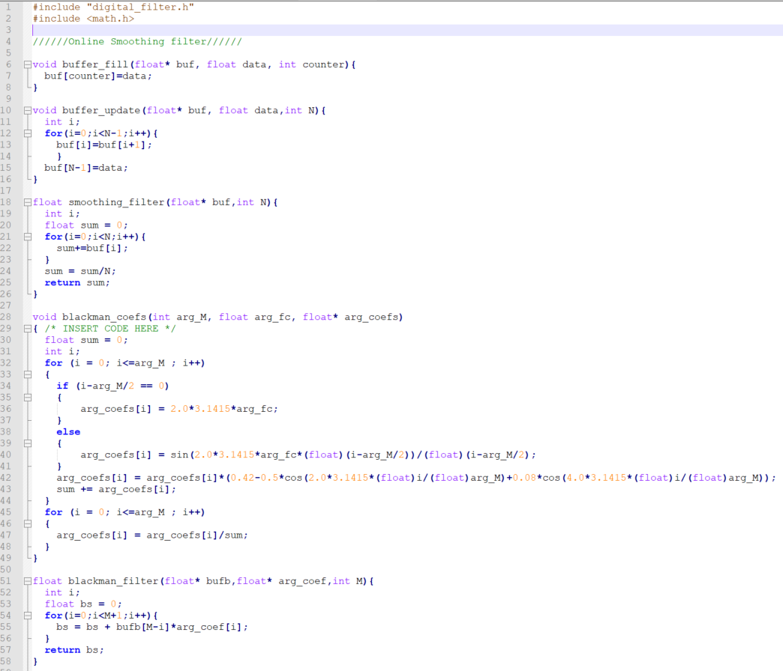
Q3 Source code continued
digital_filter.c

Slide 7
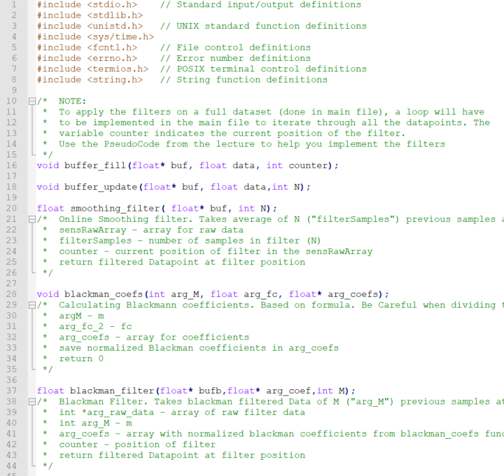
Q3 Source code continued
digital_filter.h

Slide 8
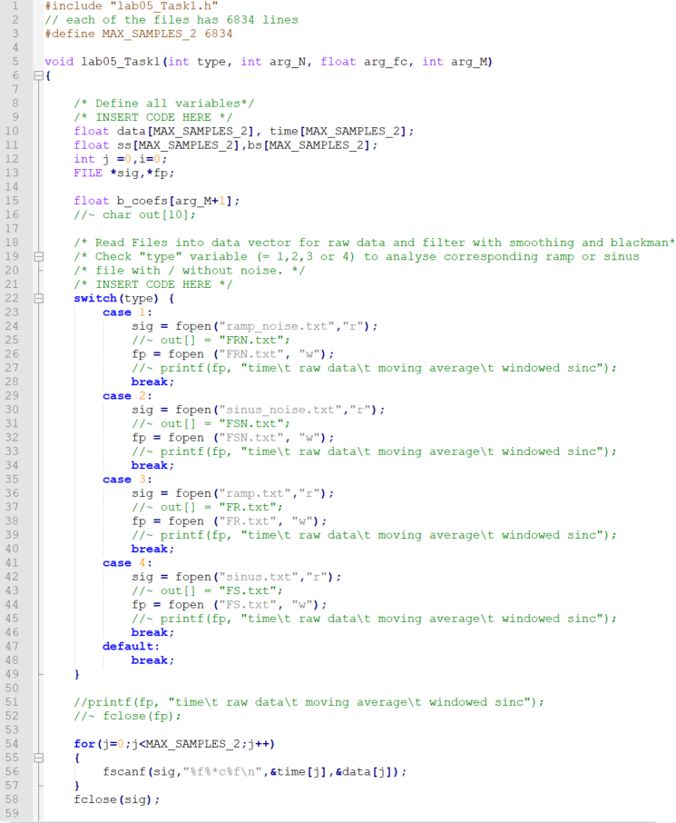
Q3 Source code continued
Lab05_task1.c

Slide 9
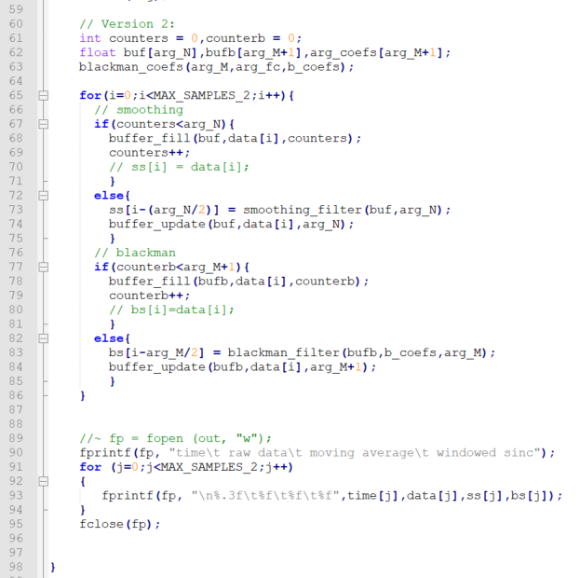
Q3 Source code continued
Lab05_task1.c

Slide 10
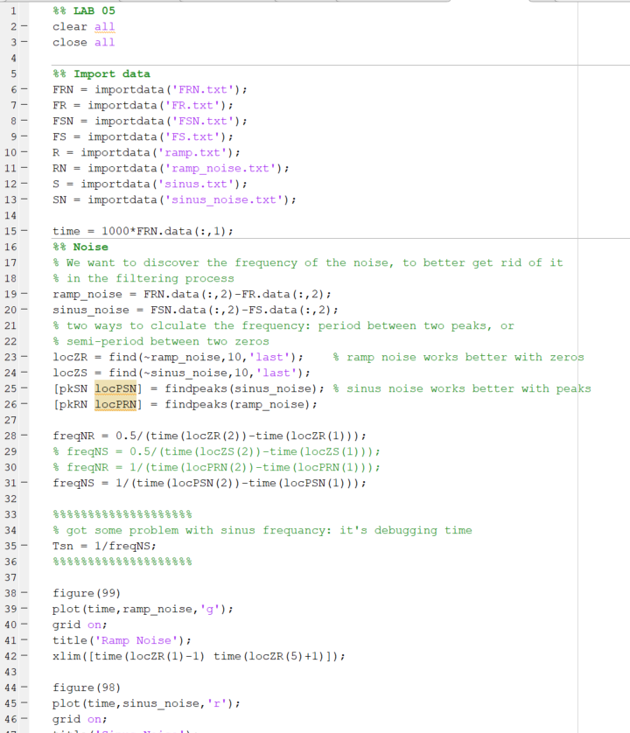
Q3 Source code continued
Matlab:

Slide 11
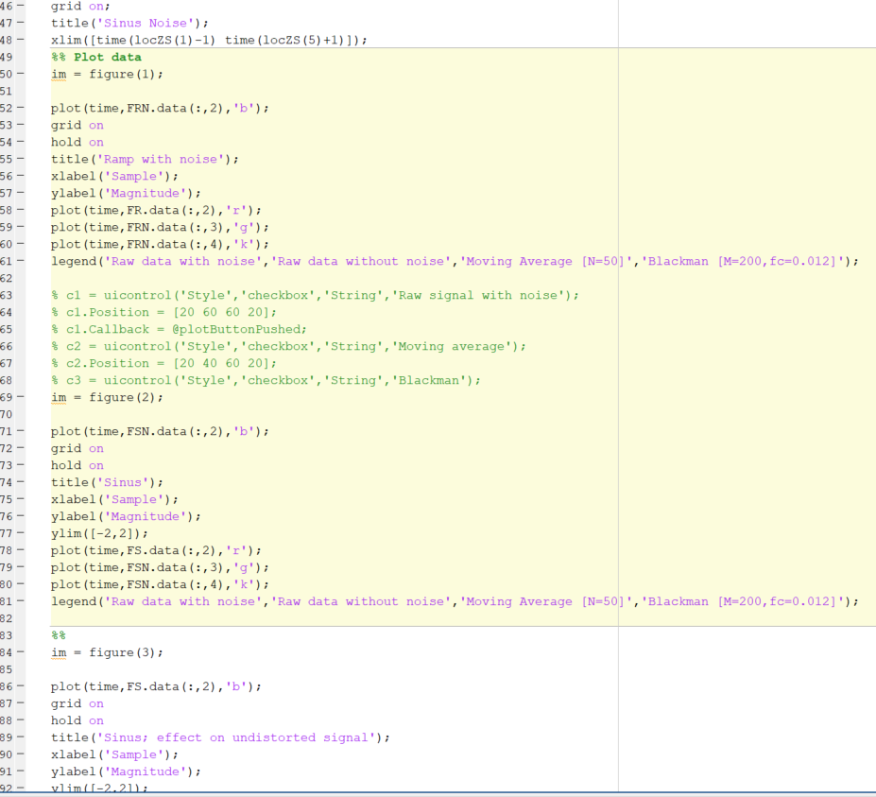
Q3 Source code continued
Matlab:

Slide 12
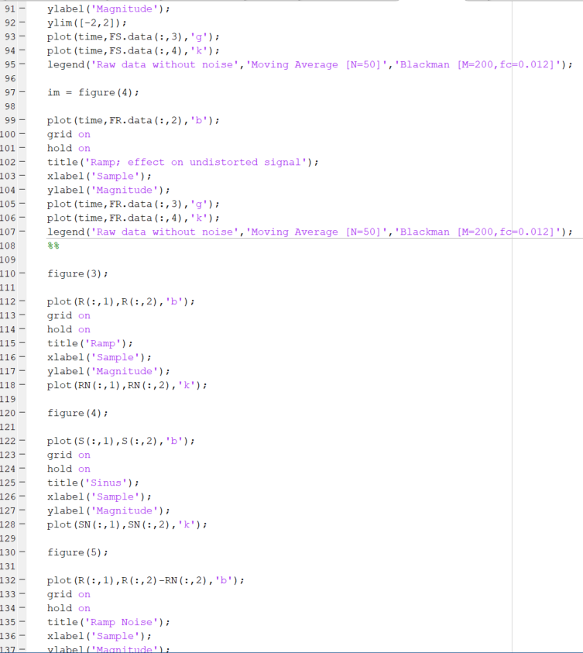
Q3 Source code continued
Matlab:

Slide 13
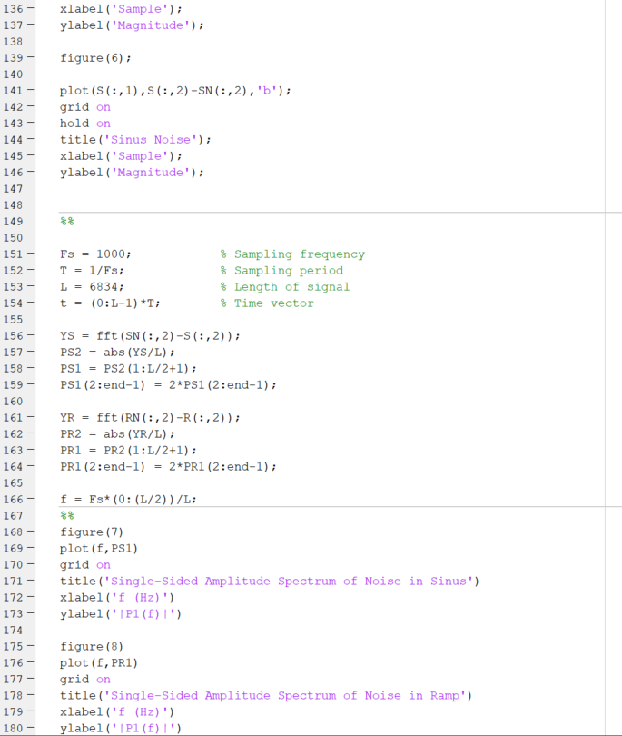
Q3 Source code continued
Matlab:

